Slide 1
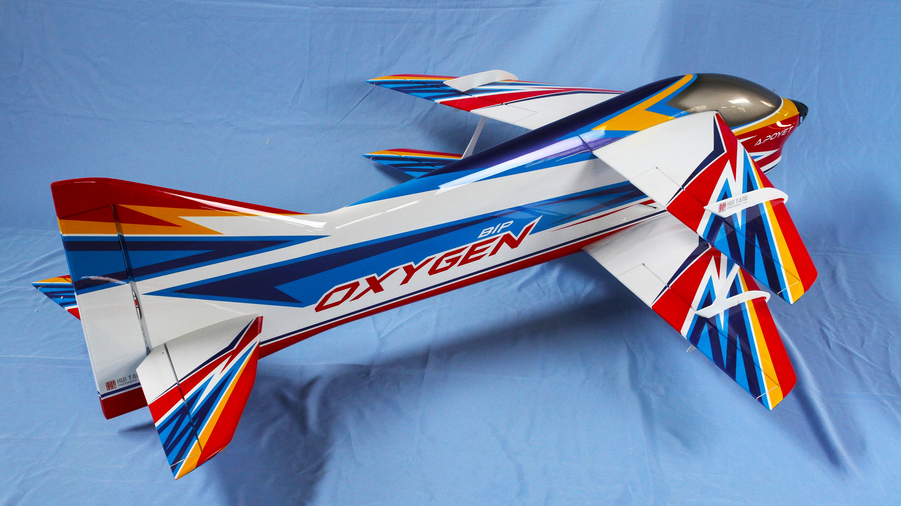
Flying and Judging F3A
F3A P-25 飞行与评分指南
SCHEMATIC MANOEUVRE ILLUSTRATIONS
SCHEDULE P-25

Slide 2
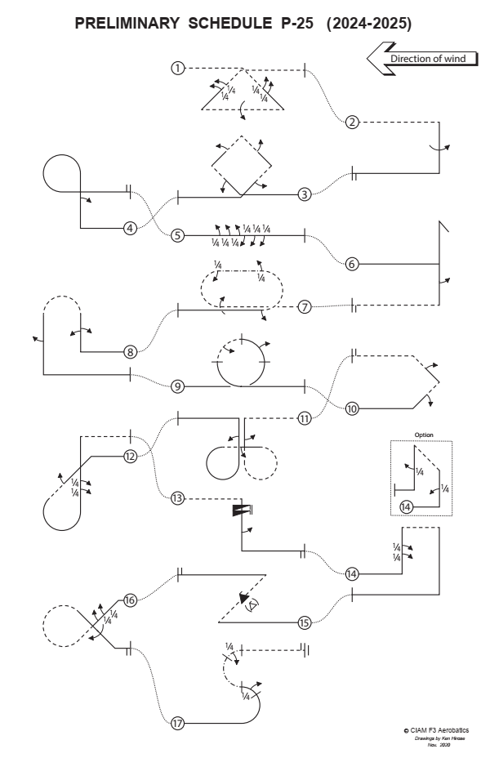
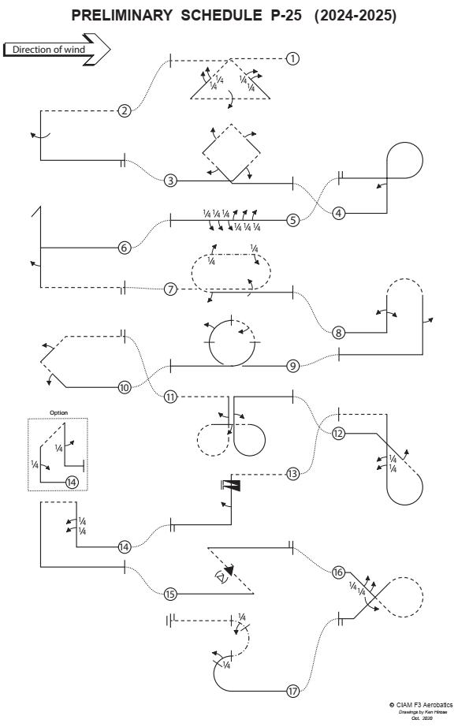

Slide 3
图形注释 Explanations:
正飞 Aircraft upright
倒飞 Aircraft inverted
正面向内的侧飞
Aircraft in Knife-Edge View from Top
背面向内的侧飞
Aircraft in Knife-Edge View from Below
位滚 part roll
半滚 half roll
横滚 roll
¼
正飞螺旋 pos. spin
倒飞螺旋 neg. spin
快滚 snap rolls
参考点 reference points
pos.
neg.

Slide 4
起飞程序
（不计分，不评分）
Take-off procedure
( not judged, not scored )
风向 wind
120⁰
安全线
Safety line

Slide 5
P-25.01 三角筋斗带滚
Triangle from Top with two quarter rolls, roll, quarter rolls
¼ 位滚
¼ 位滚
¼ 位滚
¼ 位滚
一周滚
倒飞进入，通过中心线拉1/8圆弧，进入45°向下直线，连续做两个1/4位滚，推3/8圆弧进入倒飞，在底边中间位置做一周横滚，推3/8圆弧进入45°向上直线，连续做两个1/4位滚，拉1/8圆弧，倒飞改出。From inverted, in the center pull through a one eighth loop into a forty-five degree downline, perform consecutively two quarter rolls, push through a three eighths loop, perform a roll, push through a three eighths loop into a forty-five degree upline, perform consecutively two quarter rolls, pull through a one eighth loop, exit inverted.
P-25.01.01

Slide 6
P-25.01 三角筋斗带滚
Triangle from Top with two quarter rolls, roll, quarter rolls
两个¼位滚在直线段的中间
¼ rolls centered on middle of the line.
¼
¼
所有圆角半径相等All radii are equal.
¼
¼
两个¼位滚之间的线段必须短且长度易于辨识。
Lines between part rolls must be short and of recognisable length.
45°
横滚位于直线段的中间
Roll in the center.
P-25.01.02

Slide 7
P-25.02 半方筋斗带一周滚
Half Square Loop with roll
一周横滚
倒飞进入，拉1/4圆弧进入垂直下降直线，做一周横滚，拉1/4圆弧，正飞改出。
From inverted, pull through a quarter loop into a vertical downline, perform a roll, pull through a quarter loop, exit upright.
P-25.02.01

Slide 8
P-25.02 半方筋斗带一周滚
Half Square Loop with roll
横滚位于直线段的中间
Roll on middle of the line.
所有圆角半径相等All radii are equal.
P-25.02.02

Slide 9
P-25.03 斜方筋斗，四边带半滚
Square Loop on corner with half roll, half roll, half roll, half roll
半滚
半滚
半滚
半滚
正飞进入，通过中线拉1/8圆弧进入45°上升直线，做半滚，推1/4圆弧进入45°上升直线，做半滚，拉1/4圆弧进入45°下降直线，做半滚，推1/4圆弧进入45°下降直线，做半滚，拉1/8圆弧，正飞改出。
From upright, in the center pull through a one eighth loop into a forty-five degree upline, perform a half roll, push through a quarter loop into a forty-five degree upline, perform a half roll, pull through a quarter loop into a forty-five degree downline, perform a half roll, push through a quarter loop into a forty-five degree downline, perform a half roll, pull through a one eighth loop, exit upright.
P-25.03.01

Slide 10
P-25.03 斜方筋斗，四边带半滚
Square Loop on corner with half roll, half roll, half roll, half roll
半滚位于直线段的中间
½ rolls on middle of the line.
所有圆角半径相等All radii are equal.
45°
P-25.03.02

Slide 11
P25.04 9字带半滚
Figure Nine with half roll
半滚
正飞进入，拉1/4圆弧进入垂直上升直线，做半滚，拉3/4圆弧，正飞改出。
From upright, pull through a quarter loop into a vertical upline, perform a half roll, pull through a three quarter loop, exit upright.
P-25.04.01

Slide 12
P25.04 9字带半滚
Figure Nine with half roll
半滚位于直线段的中间
½ rolls on middle of the line.
所有圆角半径相等All radii are equal.
P-25.04.02

Slide 13
P-25.05 六位双向1/4滚
Roll Combination with three quarter rolls, three quarter rolls in opposite direction
¼
位滚
¼
位滚
¼
位滚
¼
位滚
¼
位滚
¼
位滚
正飞进入，连续做三个1/4位滚，紧接着再做反向连续三个1/4位滚，正飞改出。
From upright, perform consecutively three quarter rolls, followed by three consecutive quarter rolls in opposite direction, exit upright.
P-25.05.01

Slide 14
P-25.05 六位双向1/4滚
Roll Combination with three quarter rolls, three quarter rolls in opposite direction
¼位滚之间的线段必须短且长度易于辨识。
Lines between part rolls must be short and of recognisable length.
¼
¼
¼
¼
¼
¼
在两个反向滚之间不能有直线段。
Between rolls and part rolls in opposite direction there must be no line.
P-25.05.02

Slide 15
P-25.06 失速倒转带半滚
Stall Turn with half roll
倒转前有短暂停顿Stop before pivot
(slight hesitation)
围绕重心倒转Pivot on CG
半滚
正飞进入，拉1/4圆弧进入垂直上升直线，做失速倒转进入垂直下降直线，做半滚，推1/4圆弧，倒飞改出。
From upright, pull through a quarter loop into a vertical upline, perform a stall turn into a vertical downline, perform a half roll, push through a quarter loop, exit inverted.
P-25.06.01

Slide 16
P-25.06 失速倒转带半滚
Stall Turn with half roll
倒转前有短暂停顿Stop before pivot
(slight hesitation)
偏移幅度大于等于两倍翼展 = 0分
Two wing spans or more
– zero points!
围绕重心倒转Pivot on CG
半滚位于直线段的中间
½ rolls on middle of the line.
所有圆角半径相等All radii are equal.
P-25.06.02

Slide 17
P-25.07 双殷麦曼带滚
Double Immelman with roll, quarter roll, quarter roll, half roll
¼ 位滚
侧飞直线
¼ 位滚
一周滚
半滚
倒飞进入，做横滚一周后立即推起做半筋斗，紧接着做1/4位滚进入侧飞直线，做1/4位滚恢复正飞，紧接着推半筋斗接半滚，正飞改出。
From inverted, perform a roll, push through a half loop, perform a quarter roll into knife-edge flight, perform a quarter roll (back to upright flight), push through a half loop, perform a half roll, exit upright.
P-25.07.01

Slide 18
P-25.07 双殷麦曼带滚
Double Immelman with roll, quarter roll, quarter roll, half roll
¼
侧飞直线，机翼必须保持与地面垂直
During the knife edge the wing must be in the vertical plane.
第一个1/4滚必须紧接着半筋斗
The first ¼ roll must follow immediately after the half loop.
第二段1/2圆弧必须紧接着1/4滚
The second half loop must follow immediately after the ¼ roll.
¼
半筋斗必须紧跟在横滚之后
The half loop must follow immediately after the roll.
所有圆角半径相等All radii are equal.
半滚必须紧接着半筋斗
The ½ roll must follow immediately after the second half loop.
½ roll
P-25.07.02

Slide 19
P-25.08 驼峰带双向半滚+半滚
Humpty Bump with two consecutive half rolls in opposite direction, half roll
半滚
半滚
半滚
正飞进入，拉1/4圆弧进入垂直上升直线，做双向半滚，推半筋斗进入垂直下降直线，做半滚，拉1/4圆弧，正飞改出。
From upright, pull through a quarter loop into a vertical upline, perform consecutively two half rolls in opposite direction, push through a half loop into a vertical downline, perform a half roll, pull through a quarter loop, exit upright.
P-25.08.01

Slide 20
P-25.08 驼峰带双向半滚+半滚
Humpty Bump with two consecutive half rolls in opposite direction, half roll
半滚位于直线段的中间
½ rolls on middle of the line.
在两个反向半滚之间不能有直线段。
Between rolls and part rolls in opposite direction there must be no line.
所有圆角半径相等All radii are equal.
P-25.08.02

Slide 21
P-25.09 筋斗带双向1/2同步滚
Loop with two half rolls integrated
½ 同步滚
½ 同步滚
正飞进入，做一个筋斗，在筋斗的第二段90°圆弧上做1/2同步滚，紧接着在第三段90°圆弧上反向做1/2同步滚，正飞改出。
From upright, pull through a loop while integrating a half roll in the second ninety degrees and another half roll in opposite direction in the third ninety, exit upright.
P-25.09.01

Slide 22
P-25.09 筋斗带双向1/2同步滚
Loop with two half rolls integrated
½ 滚转同步
90°
90°
½ 滚转同步
½滚必须与1/4圆弧的轨迹同步
½ rolls must be integrated on circular flightpath of the quarter loops.
筋斗必须是正圆
Loop must be round.
P-25.09.02

Slide 23
P-25.10 半斜方筋斗带半滚
Half Square Loop on Corner with half roll, half roll
半滚
半滚
正飞进入，拉1/8圆弧进入45°上升直线，做半滚，推1/4圆弧进入45°上升直线，做半滚，拉1/8圆弧，倒飞改出。
From upright, pull through a one eighth loop into a forty-five degree upline, perform a half roll, push through a quarter loop into a forty-five degree upline, perform a half roll, pull through a one eighth loop, exit inverted.
P-25.10.01

Slide 24
P-25.10 半斜方筋斗带半滚
Half Square Loop on Corner with half roll, half roll
半滚位于直线段的中间
½ rolls on middle of the line.
所有圆角半径相等All radii are equal.
45°
P-25.10.02

Slide 25
P-25.11 半四叶草带半滚
Half Cloverleaf with half roll, half roll, half roll
半滚
半滚
半滚
倒飞进入，拉1/4圆弧进入垂直下降直线，做半滚，推3/4圆弧进入水平直线，做半滚进入倒飞，拉3/4圆弧进入垂直上升直线，做半滚，推1/4圆弧，正飞改出。
From inverted, pull through a quarter loop into a vertical downline, perform a half roll, push through a three quarter loop into a horizontal line, perform a half roll, pull through a three quarter loop into a vertical upline, perform a half roll, push through a quarter loop, exit upright.
P-25.11.01

Slide 26
P-25.11 半四叶草带半滚
Half Cloverleaf with half roll, half roll, half roll
所有圆角半径相等All radii are equal.
半滚位于直线段的中间
½ rolls on middle of the line.
P-25.11.02

Slide 27
P-25.12 水滴带半滚+1/4位滚
Reverse Figure ET with half roll, two quarter rolls
半滚
¼位滚
¼位滚
正飞进入，推1/8圆弧进入45°下降直线，做半滚，拉5/8圆弧进入垂直上升直线，连续做两个1/4位滚，拉1/4圆弧，倒飞改出。
From upright, push through a one eighth loop into a forty-five degree downline, perform a half roll, pull through five eighths loop into a vertical upline, perform consecutively two quarter rolls, pull through a quarter loop, exit inverted.
P-25.12.01

Slide 28
P-25.12 水滴带半滚+1/4位滚
Reverse Figure ET with half roll, two quarter rolls
半滚位于直线段的中间
½ rolls on middle of the line.
两个¼位滚在直线段的中间
¼ rolls centered on middle of the line.
¼
¼
¼位滚之间的线段必须短且长度易于辨识。
Lines between part rolls must be short and of recognisable length.
所有圆角半径相等
All radii are equal.
P-25.12.02

Slide 29
P-25.13 倒飞螺旋两周带半滚
Inverted Spin two turns, half roll
半滚
倒飞进入，连续螺旋两周进入垂直下降直线，做半滚，拉1/4圆弧，正飞改出。
From inverted, perform an inverted spin with two turns, perform a vertical downline, perform a half roll, pull through a quarter loop, exit upright.
P-25.13.02

Slide 30
P-25.13 倒飞螺旋两周带半滚
Inverted Spin two turns, half roll
快滚进入=0分 Snap entry - 0 points!
螺旋俯冲=0分 Spiral dive - 0 points!
螺旋后保持一段直线
Line after the spins.
强行进入：大幅扣分 Forced entry: downgrade.
P-25.13.01

Slide 31
P-25.14 礼帽带1/4位滚
Top hat with two quarter rolls. Option: Top hat with quarter roll, quarter roll.
¼ 位滚
¼ 位滚
正飞进入，拉1/4圆弧进入垂直上升直线，连续做两个1/4位滚，拉1/4圆弧进入倒飞直线，拉1/4圆弧进入垂直下降直线，
拉1/4圆弧，正飞改出。
From upright, pull through a quarter loop into a vertical upline, perform consecutively two quarter rolls, pull through a quarter loop into a horizontal line, pull through a quarter loop into a vertical downline, pull through a quarter loop, exit upright.
P-25.14.01

Slide 32
P-25.14 礼帽带1/4位滚
Top hat with two quarter rolls. Option: Top hat with quarter roll, quarter roll.
两个¼位滚在直线段的中间
¼ rolls centered on middle of the line.
¼位滚之间的线段必须短且长度易于辨识。
Lines between part rolls must be short and of recognisable length.
¼
¼
所有圆角半径相等
All radii are equal.
P-25.14.02

Slide 33
P-25.14 礼帽带1/4位滚
Top hat with two quarter rolls. Option: Top hat with quarter roll, quarter roll.
可选做 Option
¼ roll
¼ roll
可选做：正飞进入，拉1/4圆弧进入垂直上升直线，
做1/4位滚，拉1/4圆弧进入倒飞直线，拉1/4圆弧进入垂直下降直线，做1/4位滚，拉1/4圆弧，正飞改出。
Option: From upright, pull through a quarter loop into a vertical upline, perform a quarter roll, pull through a quarter loop into a horizontal line, pull through a quarter loop into a vertical downline, perform a quarter roll, pull through a quarter loop, exit upright.
P-25.14.03

Slide 34
P-25.14 礼帽带1/4位滚
Top hat with two quarter rolls. Option: Top hat with quarter roll, quarter roll.
可选做 Option
¼位滚位于直线段的中间
¼ rolls on middle of the line.
¼
¼
所有圆角半径相等
All radii are equal.
P-25.14.04

Slide 35
P-25.15 Z字带快滚
Figure Z with snap roll
snap roll
( )
正飞进入，拉3/8圆弧进入45°上升直线，做一个快滚，推3/8圆弧，正飞改出。
From upright, pull through a three eighths loop into a forty-five degree upline, perform a snap roll, push through a three eighths loop, exit upright.
P-25.15.01

Slide 36
P-25.15 Z字带快滚
Figure Z with snap roll
快滚可以是正快滚，也可以是负快滚
Snap roll may be positive or negative.
快滚在直线段中间
Snap roll on middle of the line.
( )
如果快滚=桶滚或者副翼滚，大幅扣分（＞5分）
If snap roll = barrel roll or aileron roll:
Severe downgrade > 5 pts.
所有圆角半径相等
All radii are equal.
45°
P-25.15.02

Slide 37
P-25.16 彗星带连续1/4位滚+一周滚
Comet with two quarter rolls, roll
¼位滚
¼位滚
一周滚
正飞进入，推1/8圆弧进入45°下降直线，连续做两个1/4位滚，推3/4圆弧进入45°下降直线，做一周滚，拉1/8圆弧，正飞改出。
From upright, push through a one eighth loop into a forty five degree downline, perform consecutively two ¼ rolls, push through a three quarter loop into a forty-five degree downline, perform a roll, pull through a one eighth loop, exit upright.
P-25.16.01

Slide 38
P-25.16 彗星带连续1/4位滚+一周滚
Comet with two quarter rolls, roll
¼
滚转位于直线段的中间
Rolls centered on middle of the line.
¼
¼位滚之间的线段必须短且长度易于辨识。
Lines between part rolls must be short and of recognisable length.
所有圆角半径相等
All radii are equal.
滚转必须在直线段的中间，
但是不要求在整个动作的中间。
Rolls on middle of the lines, but not necessarily in the center of the manoeuvre.
P-25.16.02

Slide 39
P-25.17 S带1/4同步滚
Figure S with quarter roll, quarter roll
¼ 同步滚
45°
侧飞半筋斗
¼ 同步滚
45°
半筋斗
正飞进入，拉一个半筋斗，在半筋斗靠近顶部的45°圆弧上做1/4同步滚，紧接着向高航线再做一个侧飞半筋斗，在半筋斗靠近顶部的45°圆弧上做1/4同步滚，倒飞改出。
From upright, pull through a half loop while integrating a quarter roll over the top forty-five degrees, perform a half knife-edge loop ending on top level, while integrating a quarter roll over the top forty-five degrees, exit inverted.
P-25.17.01

Slide 40
P-25.17 S带1/4同步滚
Figure S with quarter roll, quarter roll
¼同步滚
45°
半筋斗轨迹必须是圆形
Part loops must be round.
¼滚必须在半筋斗靠近顶部的45°圆弧上同步完成。
The ¼ rolls must be integrated on circular flightpath of the 45° segments of the part loops.
¼同步滚
两个半筋斗的半径相等
Radii of the part loops are equal.
45°
P-25.17.02

Slide 41
着陆程序
（不计分，不评分）
Landing procedure
( not judged, not scored )
风向
着陆方向可以与起飞方向不同。
The direction of the landing may be different to the take off.
120⁰
安全线
Safety line

Slide 42
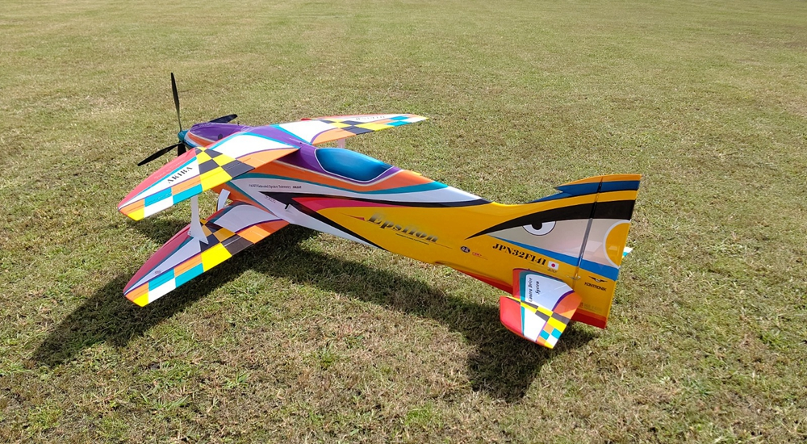
忘记谁在飞
（朋友，竞争对手，同胞，来自其他国家的选手）
忘记什么在飞
（2冲程，4冲程，电动）
只看飞机在天空中描绘的轨迹！
Forget WHO is flying
(friend, rival, countryman, flier from other nation)
Forget WHAT is flying
(2-stroke, 4-stroke, electric)
LOOK ONLY AT LINES DESCRIBED IN THE SKY!
Bob Skinner
谢谢观看！
© Peter Uhlig, February 2023
翻译：Hui Yang F3A 校对：刘爱强 2023年10月

